Slide 1
Introduction to data science
Lecture – 1 (Week 1)

Slide 2
Overview
Course and Instructor’s introduction
Understanding data
Data science intro
The process
Examples
Types of Data

Slide 3
Welcome to Intro to Data Science – fall 2022
Instructor (s):
Dr. Asma Ahmad [Sec: A, B, C]
Email: asma.ahmad@nu.edu.pk/asma.ahmad@lhr.nu.edu.pk
Office: E-52
Office Hours: will be displayed on office door shortly
Course material on Google classroom: soztyno
TA:
TBD

Slide 4
Reference Books and Resources
Cathy O'Neil and Rachel Schutt. Doing Data Science, Straight Talk From The Frontline. O'Reilly. 2014. ISBN 978-1-449-35865-5.
Jiawei Han, Micheline Kamber and Jian Pei. Data Mining: Concepts and Techniques, Third Edition. Morgan Kaufmann Publishers. 2012. ISBN 978-0-12-381479-1.
Tom Mitchell: Machine Learning
Jure Leskovek, Anand Rajaraman and Jeffrey Ullman. Mining of Massive Datasets. v2.1, Cambridge University Press. 2014.
Kevin P. Murphy. Machine Learning: A Probabilistic Perspective. MIT Press. 2013. ISBN 0262018020.
Foster Provost and Tom Fawcett. Data Science for Business: What You Need to Know about Data Mining and Data-analytic Thinking. O'Reilly 2013. ISBN 978-1-449-36132-7.

Slide 5
Tools and Software Packages
WEKA
KNIME
ORANGE
CBA
MATLAB
PYTHON
R
SPSS
SAS
ArcView GIS
Maptitude for the Web
etc.,
Language: Python
Tools: NumPy, Pandas, matplotlib, scikit-learn
Other packages if needed: SciPy, and SymPy

Slide 6
Tentative Grading Policy
Class
Assignments | 15%
Quizzes | 10%
Midterm Exam | 30%
Final Exam | 45%

Slide 7
Grading Policy
There is simply no chance of extension in any of the deadline, what so ever
You can request for re-checking of any of your evaluation as per following rules;
Exams: Same day
Assignments: 2 days after handing-over
Quizzes: 2 days after handing over
Warning! After due time, request will not be considered even if it’s genuine.
Warning! Regularly check flex and don’t come in the end with bulk of queries in hand.

Slide 8
General Guidelines
Visit Google classroom regularly for updates
No email submissions when Google classroom is there. Always remember that, you are putting your task in trash by yourself when you are emailing it.
Cheating cases are intolerable. You will be given negative marks for cheated stuff irrespective of the fact that, you were provider or the other one. Your cheating in exam will make it easy for you to step down from the Course with an ‘F’ grade. . . ☹
There will be no re-take of any evaluation if you haven’t informed earlier through a proper channel.
Quiz is inevitable so always, expect a One ☺ [at least, one in every week]

Slide 9
General Guidelines
You have to depend on yourself to have a good grade in the course
You need to appear in demo to have it graded otherwise you will be given 5% of the total marks even if it was best assignment/project of the class
Grading will be individual even for group tasks.
There will always be a quiz of written assignments whose performance will be considered as performance in that assignment.

Slide 10
Tentative Outline
Dimensionality Reduction
Outlier Detection
Statistical Inference
Statistical Modeling
Probability distribution
Fitting a model
Descriptive and Exploratory Analysis
Market Basket Analysis: Market basket analysis is a data mining technique used by retailers to increase sales by better understanding customer purchasing patterns
Exploratory Data Analysis [EDA]
Data Visualization
Introduction & Applications
Data (Acquisition, Storage, & processing)
Data Preprocessing and Mining
Classification
Clustering
Association Rule Mining
Attribute selection (Feature Selection)
Machine Learning
Classification and Regression
Gradient Descent
Regularization
Support Vector Machines

Slide 11

Learning Outcomes
Understand the basics of Data Science,
Prepare and wrangle the data for analysis
Perform Exploratory Data Analysis (EDA)
Understand and apply machine learning algorithms to gain insight from the data
Notes:
perform exploratory data analysis to investigate data so as to discover patterns, to spot anomalies, to test hypothesis and to check assumptions with the help of summary statistics and graphical representations,

Slide 12

Why do we need Data Science?
Big Data
“Between the dawn of civilization and 2003, we only created ﬁve exabytes of information; now we’re creating that amount every two days.”
- Eric Schmidt, Google
Good decisions require good information derived from raw facts
Notes:
CEO from 2001 - 2011

Slide 13
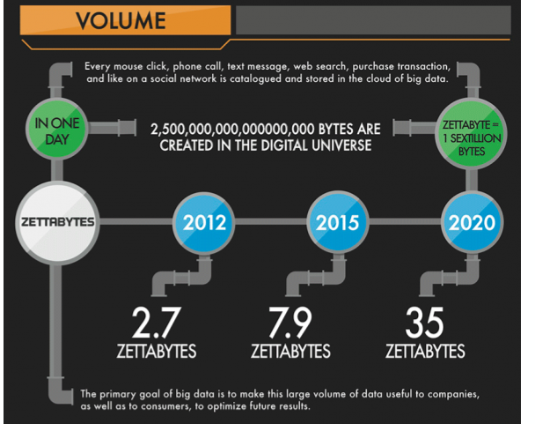
Why do we need Data Science?

Slide 14
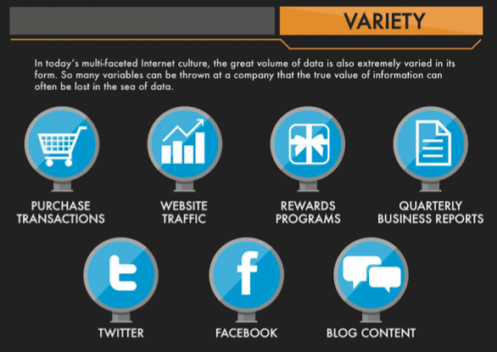
Why do we need Data Science

Slide 15
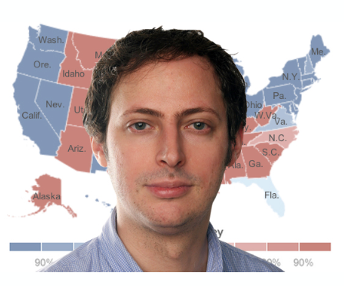
Nate Silver
American Data Scientist who analyzes elections and baseball. -PECOTA: a system for forecasting the performance and career development of Major -League Baseball players. - 2012 U.S. Presidential election

Slide 16
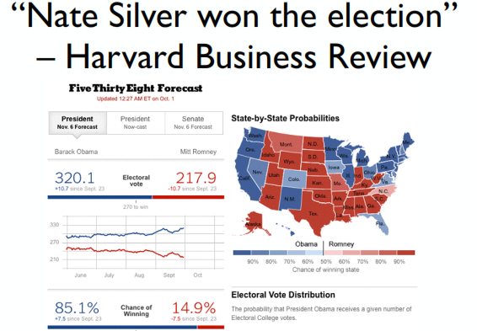
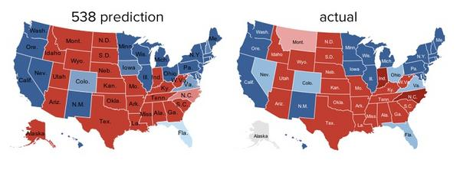
2012 U.S. Presidential election
Correctly predicted the winners of all the states.
2012 U.S. Presidential election
Correctly predicted the winners of all the states.

Slide 17
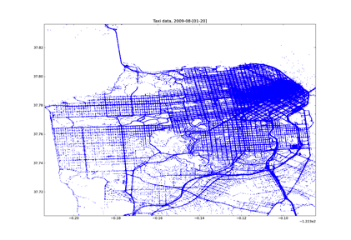
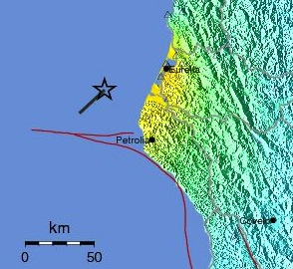

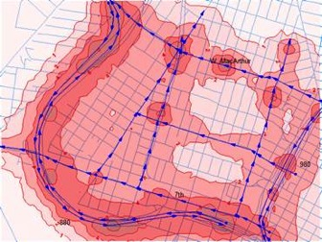
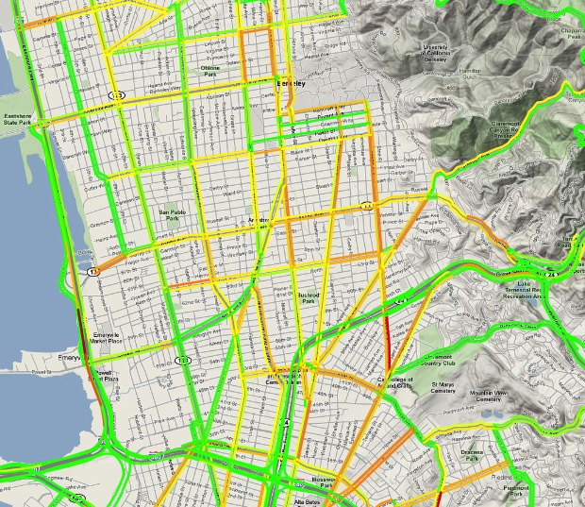
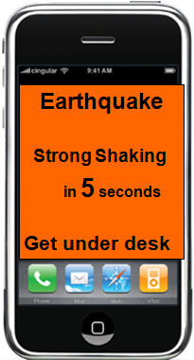
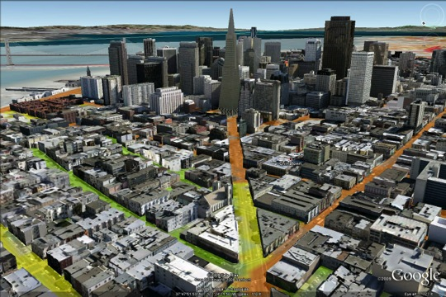
What can you do with the data?
Crowdsourcing + physical modeling + sensing + data assimilation
to produce:
From Alex Bayen, UCB
Notes:
Data assimilation is typically a sequential time-stepping procedure, in which a previous model forecast is compared with newly received observations, the model state is then updated to reflect the observations, a new forecast is initiated, and so on.

Slide 18
Data vs. Information
Data
Information
Raw facts
Have not yet been processed to reveal their meaning to the end user
Building blocks of information
Data management
Generation, storage, and retrieval of data
Produced by processing raw data to reveal its meaning
Requires context
Bedrock of knowledge
Should be accurate, relevant, and timely to enable good decision making

Slide 19
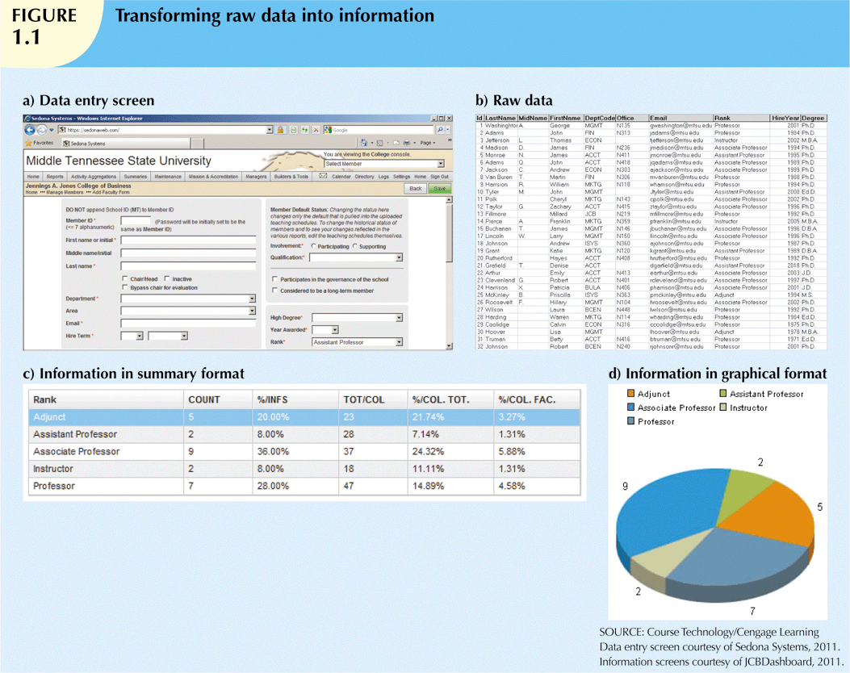
Data vs. Information (cont’d.)

Slide 20
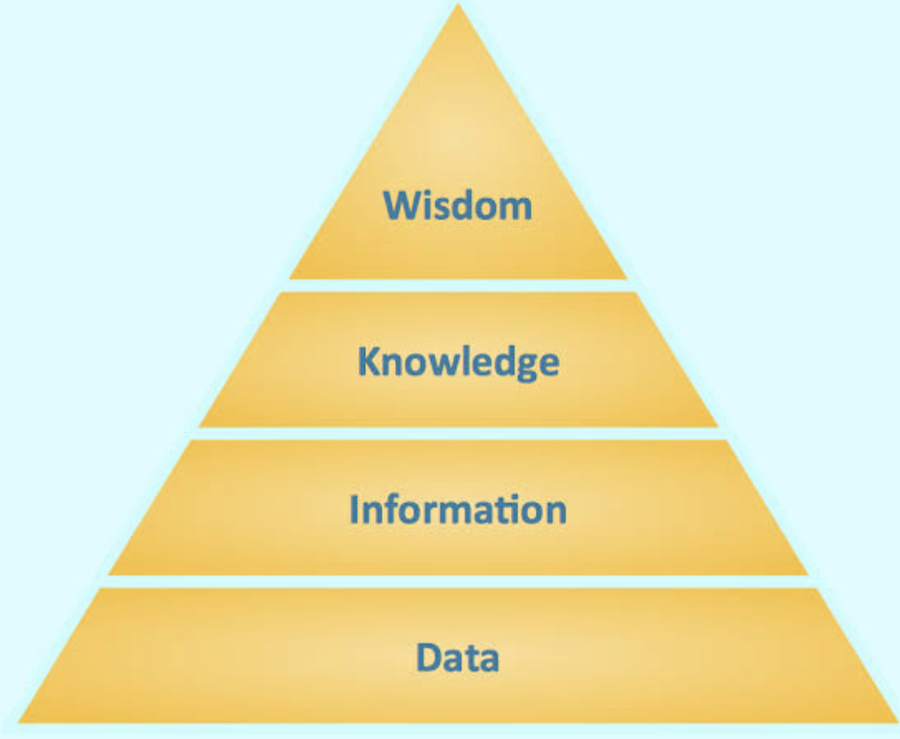
Data, Information, and Beyond

Slide 21
What is Data Science?
Data Science is the application of computational and statistical techniques to address or gain insight into some problem in the real world
Data Science = Statistics + data processing + machine learning + scientific inquiry + visualization + business analytics + big data + …

Slide 22

Contrast: Databases
Datawarehouse | Data Science
Querying the past | Querying the future
Business intelligence (BI) is the transformation of raw data into meaningful and useful information for business analysis purposes. BI can handle enormous amounts of unstructured data to help identify, develop and otherwise create new strategic business opportunities - Wikipedia
Notes:
Querying the future:
What happens if I show this ad?
Or recommend this product?
Or filter this email?
Microsoft lost an estimated $1.7B on Surface computers (past) but what do they expect to make in future?

Slide 23
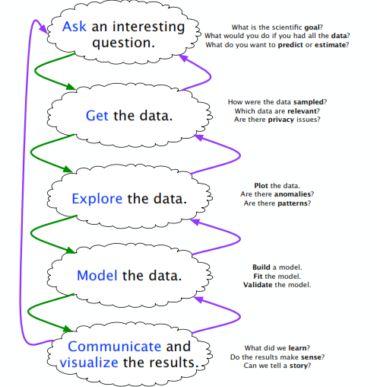
Introduction to Optimization

Slide 24
Some Key Principles
use many data sources
understand how the data were collected (sampling is essential)
weight the data thoughtfully (not all polls are equally good)
use statistical models (not just hacking around in Excel)
understand correlations (e.g., states that trend similarly)
have good communication skills (What does a 60% probability even mean? How can we visualize, validate, and understand the conclusions?)

Slide 25
Big Data – Five V of Data
Volume:
How much data is really relevant to the problem solution? Cost of processing?
So, can you really afford to store and process all that data?
Velocity:
Much data coming in at high speed
Need for streaming versus block approach to data analysis
So, how to analyze data in-flight and combine with data at-rest
Variety:
A small fraction is structured formats, Relational, XML, etc.
A fair amount is semi-structured, as web logs, etc.
The rest of the data is unstructured text, photographs, etc.
So, no single data model can currently handle the diversity
Notes:
Volume
Volume, the first of the 5 V's of big data, refers to the amount of data that exists. Volume is like the base of big data, as it is the initial size and amount of data that is collected. If the volume of data is large enough, it can be considered big data. What is considered to be big data is relative, though, and will change depending on the available computing power that's on the market.
Velocity
The next of the 5 V's of big data is velocity. It refers to how quickly data is generated and how quickly that data moves. This is an important aspect for companies need that need their data to flow quickly, so it's available at the right times to make the best business decisions possible.
As an example, in healthcare, there are many medical devices made today to monitor patients and collect data. From in-hospital medical equipment to wearable devices, collected data needs to be sent to its destination and analyzed quickly.
Variety
The next V in the five 5 V's of big data is variety. Variety refers to the diversity of data types. An organization might obtain data from a number of different data sources, which may vary in value. Data can come from sources in and outside an enterprise as well. The challenge in variety concerns the standardization and distribution of all data being collected.

Slide 26
Big Data – Five V of Data (Cont.)
Veracity: cover term for …
Accuracy, Precision, Reliability, Integrity
So, what is it that you don’t know you don’t know about the data?
Value:
How much value is created for each unit of data (whatever it is)?
So, what is the contribution of subsets of the data to the problem solution?
Notes:
Veracity
Veracity is the fourth V in the 5 V's of big data. It refers to the quality and accuracy of data. Gathered data could have missing pieces, may be inaccurate or may not be able to provide real, valuable insight. Veracity, overall, refers to the level of trust there is in the collected data.
Value
The last V in the 5 V's of big data is value. This refers to the value that big data can provide, and it relates directly to what organizations can do with that collected data. Being able to pull value from big data is a requirement, as the value of big data increases significantly depending on the insights that can be gained from them.

Slide 27
Types of Data Analytics
Descriptive: A set of techniques for reviewing and examining the data set(s) to understand the data and analyze business performance.
Diagnostic: A set of techniques to determine what has happened and why
Predictive: A set of techniques that analyse current and historical data to determine what is most likely to (not) happen
Notes:
Descriptive: What happened?? Plots etc
Diagnostic analysis takes the insights found from descriptive analytics and drills down to find the causes of those outcomes. Certain sale went up for all stores except three

Slide 28
Types of Data Analytics (Cont.)
Prescriptive: A set of techniques for computationally developing and analyzing alternatives that can become courses of action – either tactical or strategic – that may discover the unexpected
Decisive: A set of techniques for visualizing information and recommending courses of action to facilitate human decision-making when presented with a set of alternatives.

Slide 29
Data Science Life Cycle
Problem Understanding: It all starts with understanding the problem at hand, the questions, and the answers we are trying to find from the dataset at hand.
Data Acquisition: Data Acquisition, as the name suggests, is about retrieving the data with the help of Data Engineers where required. It also consolidates all of the data required to answer the question or to solve the problem at hand.
Data Wrangling: Data wrangling is about using knowledge to preprocess data. It involves looking for missing values and asking business questions like why they are missing. Furthermore, it uses knowledge to give shape to the dataset appropriate for visualizations and to support the coming steps in the life cycle.
Data Exploration: Data Exploration is about visualization and other statistics’ measures to see whether the questions we asked, in the beginning, are being answered or not? The data analyst’s job ends here.
Feature Engineering and Selection: It is a preprocessing step before modeling in both Machine Learning and Deep Learning. We will look into these fields in the coming sections. It has similar steps to Data Wrangling apart from some algorithms for Feature Selection and transformation.
Modeling: Modeling is the process that uncovers the meaning of the data. It is about capturing underlying trends and the data’s behavior to make the model, which can be used for predictive analytics as described in the previous section.
Deployment: After we build the model we’ll deploy it in the most efficient and optimized manner so that real-world people can use it. It can be deployed on mobile applications and web applications.
Monitoring: After we have deployed the model, we will want to monitor it. Monitoring is about familiarizing the model with the new dataset and tracking the number of requests that the model receives. It also involves making changes to the analysis and starting over if required.

Slide 30
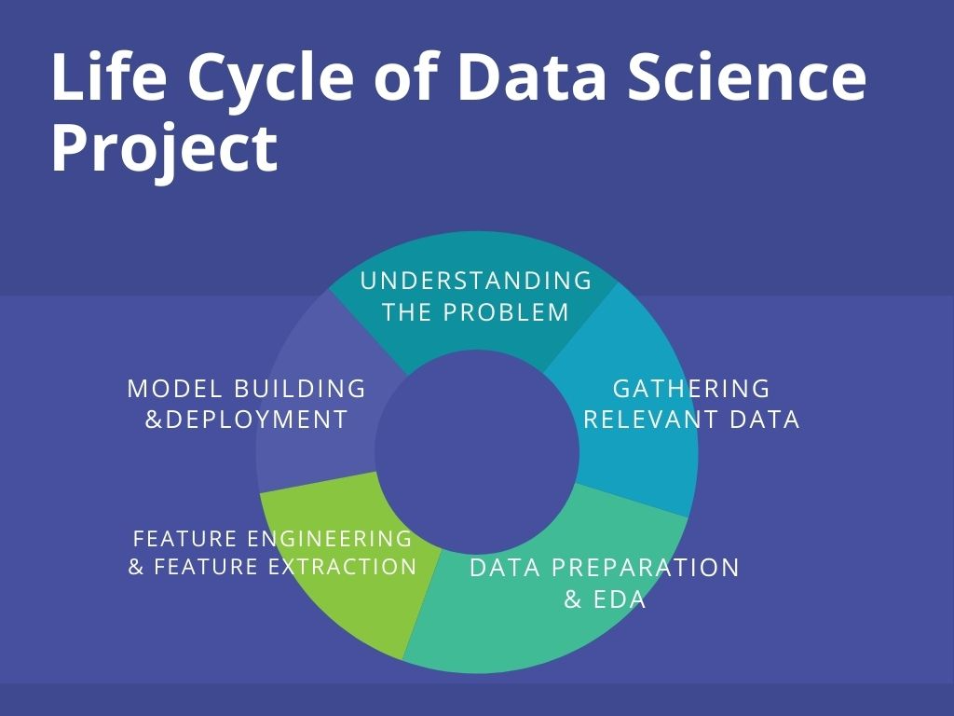

Slide 31
Asking Good Questions
Software developers are not encouraged to ask questions, but data scientists are:
What exciting things might you be able to learn from a given data set?
What things do you/your people really want to know?
What data sets might get you there?
e.g., Baseball
How to best measure individual player’s skill, value or performance?
How fair do trades between teams work out?
What is the trajectory of player’s performances as they mature and age?
To what extent does batting performance correlate with the position played?

Slide 32
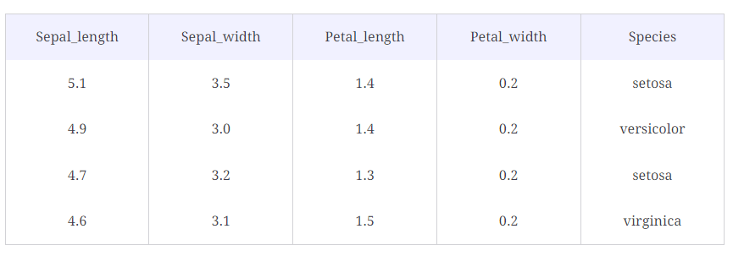
Structured vs. Semi-Structured vs. Unstructured Data
Structured Data
It comes with a predefined format and structure. Structured Data is usually stored in Relational Databases. It is easy to deal with in the Data Science domain.

Slide 33
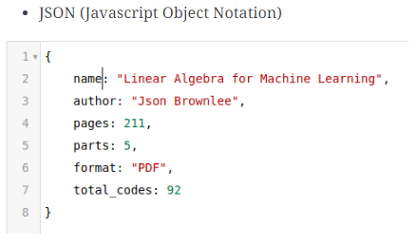
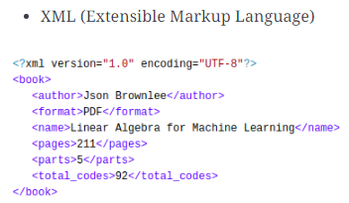
Semi-Structured Data#
It comes with a predefined format and structure but is not stored in the Relational Database.

Slide 34
Unstructured Data
It does not have a specific format and lacks structure. It is the type of data that presents many challenges to handle in the Data Science domain
Examples:
Images
Videos
Speech

Slide 35
THAT’S IT FOR TODAY!

